Slide 1


Robotics
Coding
Games and Apps Development
HUMANOID ROBOT – ASSEMBLING AND PROGRAMMING
3D Printing
…Nurturing STEM Skills for the future
www.brainiacs.com.ng
Learn, Play, Innovate

Slide 2
Knowledge Harvest
How do describe a humanoid robot ?
What is 3D modelling and how does it apply to designing a humanoid robot?
How do you convert a 3D model into a format suitable for 3D printing?
www.brainiacs.com.ng
Learn, Play, Innovate
Notes:
Run a virtual bee-bot

Slide 3

Wow Factor
www.brainiacs.com.ng
Learn, Play, Innovate

Slide 4

Key Skills to Learn
Critical Thinking.
Computational Thinking
Team Work.
Analytical Reasoning.
Creativity
www.brainiacs.com.ng
Learn, Play, Innovate

Slide 5
Learning Objectives
At the end of the lesson the pupils should be able to:
Identify materials required to build a humanoid robot.
Assemble a humanoid robot.
iii. Program a humanoid robot to make a simple directional movement as well as sense an obstacle.
www.brainiacs.com.ng
Learn, Play, Innovate

Slide 6
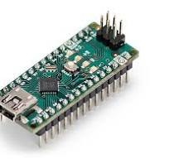
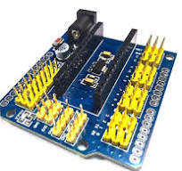

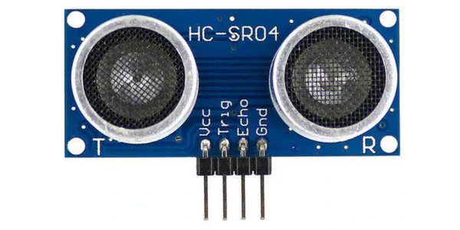
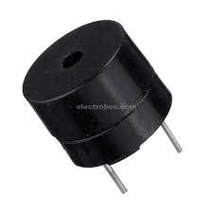
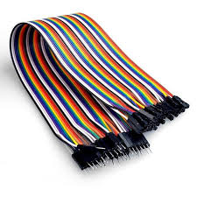
Materials Needed to Assemble a Humanoid Robot
To design a Humanoid Robot the following materials will be needed:
Arduino Nano ii. Arduino Nano Shield iii. USB Cable
iv. Ultrasonic Sensor v. Buzzer vi. Jumper cable
www.brainiacs.com.ng
Learn, Play, Innovate

Slide 7
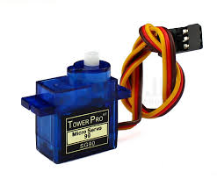
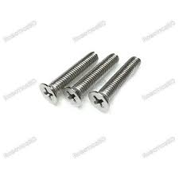
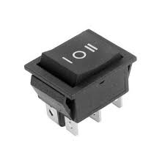
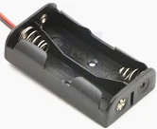
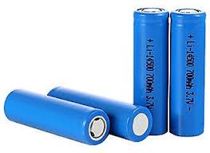
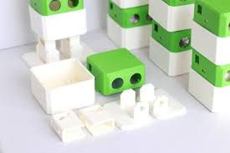
Materials Needed to Assemble a Humanoid Robot
To assemble a Humanoid Robot the following materials will be needed:
vii. Micro Servo viii. Switch ix Screws
x. AA Battery Holder xi AA Battery . 3D designs
www.brainiacs.com.ng
Learn, Play, Innovate

Slide 8
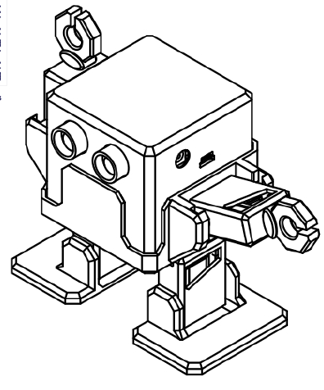
Assembling a Humanoid Robot
In our previous class, we worked on assembling your 3D designs and we got the design shown below;
www.brainiacs.com.ng
....Learn, Play, Innovate
Notes:
3D printing also called additive manufacturing is a process of making three dimensional solid objects from a digital file.
3D printed object are created using additive processes.
In an additive process, an object is created by laying down successive layers of material one layer at a time, from the bottom upwards.

Slide 9
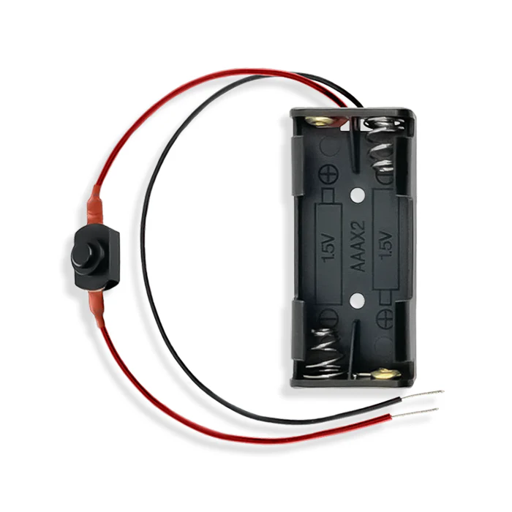
Assembling a Humanoid Robot
At this stage, we will establish the necessary connections to ensure our humanoid robot functions properly using the listed materials and following the steps below;
STEP 1: Connect the Battery holder to the switch as shown below;
www.brainiacs.com.ng
....Learn, Play, Innovate
Notes:
3D printing also called additive manufacturing is a process of making three dimensional solid objects from a digital file.
3D printed object are created using additive processes.
In an additive process, an object is created by laying down successive layers of material one layer at a time, from the bottom upwards.

Slide 10
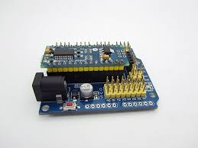
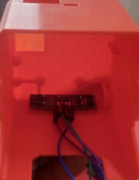
Assembling a Humanoid Robot
STEP 2 : Attach the Arduino Nano to the Arduino Shield as shown below;
Step 3: Attach the ultrasonic sensor to the head of the robot and connect jumper to the terminals as shown below;
www.brainiacs.com.ng
....Learn, Play, Innovate
Notes:
.

Slide 11
Assembling a Humanoid Robot
STEP 4: On the table below make your servo connections as directed;
Servo | Signal Pin (Yellow) | 5V (Red) | Ground (Brown)
Right Arm Servo | Pin 10 | V | G
Left Arm Servo | Pin 11 | V | G
Right Hip Servo | Pin 3 | V | G
Left Hip Servo | Pin 6 | V | G
Right Feet Servo | Pin 5 | V | G
Left Feet Servo | Pin 9 | V | G
www.brainiacs.com.ng
....Learn, Play, Innovate
Notes:
.

Slide 12
Assembling a Humanoid Robot
STEP 5: As directed on the table below, connect your ultrasonic sensor as seen;
STEP 6: As shown below, connect your buzzer as instructed;
Ultrasonic Sensor | Pins
Vcc | V
Trig | Pin 8
Echo | Pin 7
Gnd | G
Buzzer | Pins
Positive Pin (Long Pin) | Pin 2
Negative Pin (Short Pin) | G
www.brainiacs.com.ng
....Learn, Play, Innovate
Notes:
.

Slide 13
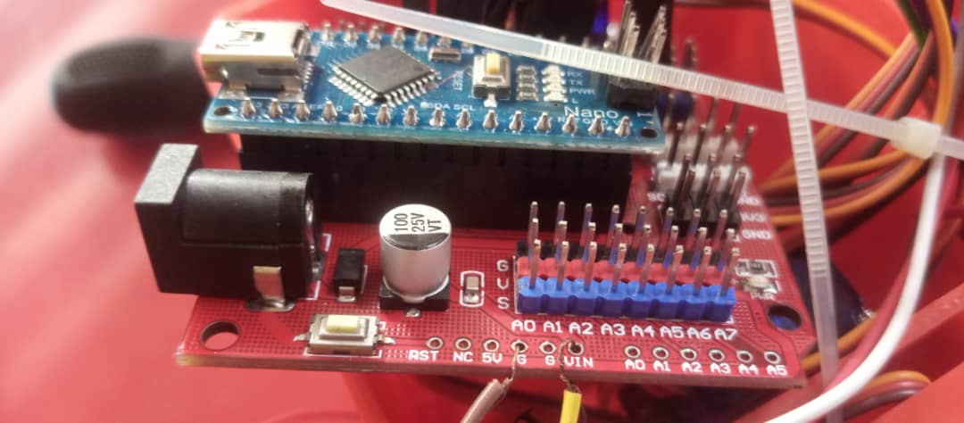
Assembling a Humanoid Robot
STEP 6 : Connect your AA battery holder to the Circuit as shown on the table and picture below;
AA Battery Holder | Pin
Positive Terminal (+ve) | Vin
Negative Terminal (-ve) | Gnd
www.brainiacs.com.ng
....Learn, Play, Innovate
Notes:
.

Slide 14
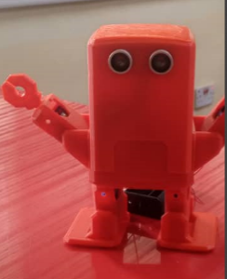
Assembling a Humanoid Robot
STEP 7 : Cover your robot and Attach your battery holder to your robot with help of a glue gun and you should have this;
www.brainiacs.com.ng
....Learn, Play, Innovate
Notes:
.

Slide 15
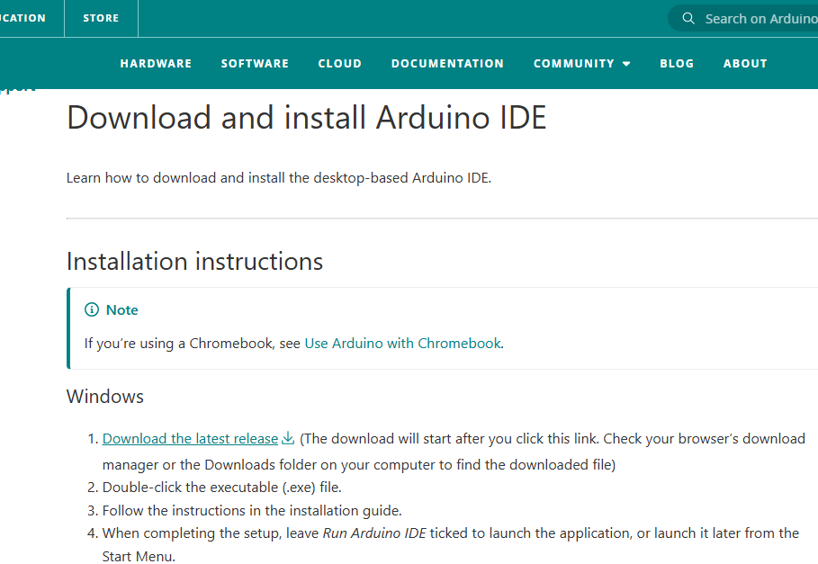
Programming a Humanoid Robot
At this moment, we have successfully completed the assembly and making of all necessary connections our robot. Now, we are ready to proceed with programming.
Next, click on the following link to download and install the https://support.arduino.cc/hc/en-us/articles/360019833020-Download-and-install-Arduino-IDE to download and install ARDUINO IDE.
STEP 1: Click here to download and install your ARDUINO IDE
www.brainiacs.com.ng
....Learn, Play, Innovate
Notes:
.

Slide 16
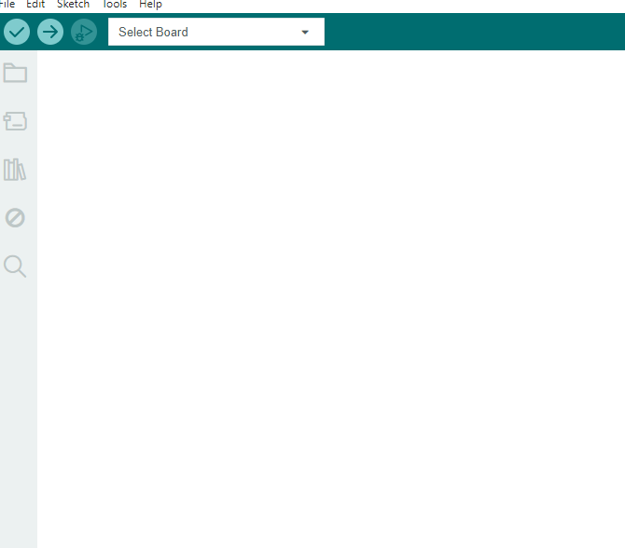
Programming a Humanoid Robot
STEP 2: After installing your ARDUINO IDE software, launch it and you should have this environment below;
STEP 3: Click on this link https://drive.google.com/file/d/1EIKH9bHLRdULcg2vNqZWIz1DZRE3ke_B/view?usp=drive_link to download your humanoid robot code.
www.brainiacs.com.ng
....Learn, Play, Innovate
Notes:
.

Slide 17
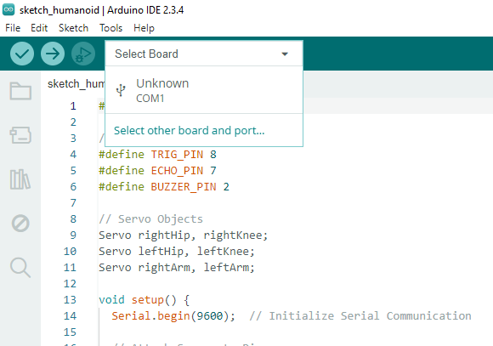
Programming a Humanoid Robot
Step 4: Click here to select the microcontroller board and port
www.brainiacs.com.ng
....Learn, Play, Innovate
Notes:
.

Slide 18
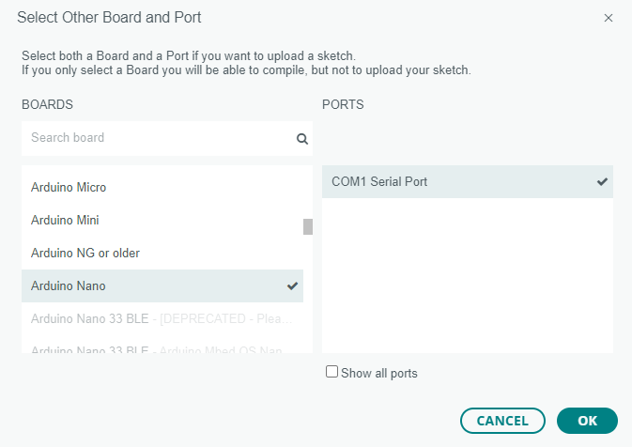
Programming a Humanoid Robot
Step 5: Scroll down to search for Arduino Nano and click on it
Step 6: Click on ‘OK’
www.brainiacs.com.ng
....Learn, Play, Innovate
Notes:
.

Slide 19
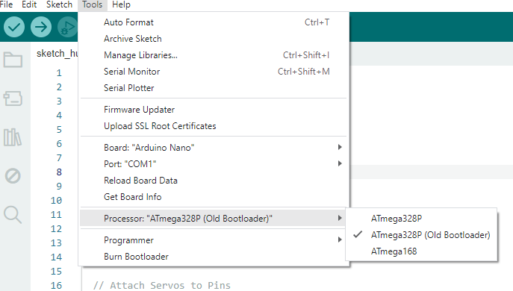
Programming a Humanoid Robot
Step 7: Click on ‘TOOLS’ and scroll down to select PROCESSOR
Step 8: Select ATmega328P(Old Bootloader) and click on it.
www.brainiacs.com.ng
....Learn, Play, Innovate
Notes:
.

Slide 20
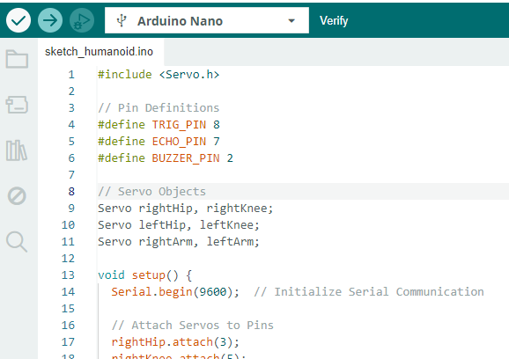
Programming a Humanoid Robot
Step 9: Click here to verify the code
Step 10: Immediately you are done verifying your code, click here to upload your code into your Arduino Nano to allow robot work.
www.brainiacs.com.ng
....Learn, Play, Innovate
Notes:
.

Slide 21
Recap
At the end of the lesson, pupils were able to:
Identify materials required to build a humanoid robot.
Assemble a humanoid robot.
Program a humanoid robot to make a simple directional movement as well as sense an obstacle.
www.brainiacs.com.ng
....Learn, Play, Innovate

Slide 22

Thank you!
www.brainiacs.com.ng
Learn, Play, Innovate

Slide 23
How you can get to us
Twitter: Brainiacs_Ng
Phone No: +234 909 109 5057
Email: brainiacsng@gmail.com
info@brainiacs.com.ng
Website: www.brainiacs.com.ng
google+: brainiacsng
Youtube Channel: Brainiacs_Ng
www.brainiacs.com.ng
Learn, Play, Innovate

